Slide 1
Key Requirements of the Construction General Permit and Tools for Compliance
Scott Taylor, P.E., D.WRE

Slide 2
CGP Fast Facts
285 page permit
All reporting is publicly available
Substantial fines for noncompliance
~7,000 active projects in CA
Requires runoff sampling for some projects
Requires self-reporting, which may lead to enforcement

Slide 3
Project Fast Facts
All projects greater than one acre must:
Conduct risk level determination
Develop a SWPPP
Pay the first annual fee
Register for permit coverage
Implement the SWPPP during construction
Stabilize all disturbed areas after construction
Submit annual reports
Terminate permit coverage

Slide 4
Historical Enforcement (Or, Why Should You Care?)
Walmart, $3.1 million
EPA, 2004, for failure to obtain stormwater permits and implement BMPs
Richmond American + other companies, $928,500
EPA, 2003, for failure to obtain stormwater permits, develop/implement SWPPPs, implement BMPs to minimize sediment discharge, and conduct site inspections
City of San Diego, $532,000
RWQCB, 2000, for failure to curb erosion from City construction sites
Caltrans, $1,600,000
RWQCB, 2011, for failure to implement effective BMPs

Slide 5
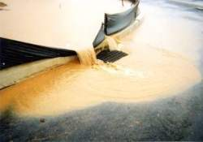
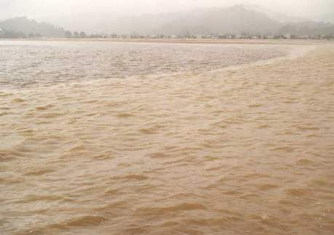
Pollutant Effects - Sediment
Increased temperature, decreased light to plants and animals in waterbody, pollutant transport

Slide 6
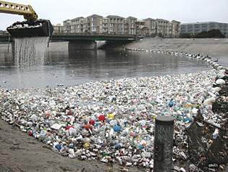
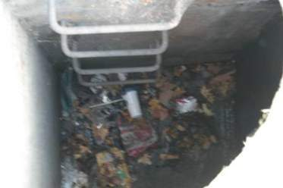
Pollutant Effects - Trash
Pollutant transport, eyesore
Notes:
Ballona creek

Slide 7
Permit Requirements
Based on project Risk Level or LUP Type
Risk Level refers to traditional, box projects
LUP Type refers to linear utility projects
A project may be Risk Level 1, 2, 3 or LUP Type 1, 2, or 3
Risk Level 1 and LUP Type 1 are the simplest

Slide 8
Compliance Activities: Risk Level 1
Task | Submittal Requirement
Weekly Inspection Report | Hold in SWPPP, submit with Annual Report
Storm Event Inspection Report (pre/during/post storm) | Hold in SWPPP, submit with Annual Report
SWPPP Modifications | Upload major modifications
Quarterly Non-Stormwater Inspection | Hold in SWPPP, submit with Annual Report
Non-visible Pollutant Monitoring | Hold in SWPPP, submit with Annual Report
Annual Report | Covers July 1 – June 30, Due September 1
Notice of Termination | Submit within 90 days of project completion

Slide 9
Compliance Activities: Risk Level 2
Task | Submittal Requirement
Weekly Inspection Report | Hold in SWPPP, submit with Annual Report
Storm Event Inspection Report | Hold in SWPPP, submit with Annual Report
Rain Event Action Plan (REAP) | Hold in SWPPP, submit with Annual Report
Weather forecast | Hold in SWPPP, submit with Annual Report
NAL compliance monitoring data | Hold in SWPPP, submit with Annual Report If NAL exceedance, submit to SMARTS within 10 days
NAL Exceedance Report | Submit to SMARTS if requested by RB
SWPPP Modifications | Upload major modifications
Quarterly Non-Stormwater Report | Hold in SWPPP, submit with Annual Report
Non-visible pollutant Monitoring | Hold in SWPPP, submit with Annual Report
Annual Report | Covers July 1 – June 30; due on September 1
Notice of Termination | Within 90 Days of project completion

Slide 10
Compliance Activities: Risk Level 3
Task | Submittal Requirement
Weekly Inspection Report | Hold in SWPPP, submit with Annual Report
Storm Event Inspection Report | Hold in SWPPP, submit with Annual Report
Rain Event Action Plan (REAP) | Hold in SWPPP, submit with Annual Report
Weather forecast | Print daily, hold in SWPPP, submit with Annual Report
NAL compliance monitoring data | Hold in SWPPP, submit with Annual Report If NAL exceedance, submit to SMARTS within 10 days
NAL Exceedance Report | Submit to SMARTS if requested by RB
NEL compliance monitoring data | Submit to SMARTS within 5 days of conclusion of rain event
NEL Violation Report | Submit to SMARTS within 24 hours of NEL violation
SWPPP Modifications | Upload major modifications
Quarterly Non-Stormwater Report | Hold in SWPPP, submit with Annual Report
Non-visible pollutant Monitoring | Hold in SWPPP, submit with Annual Report
Annual Report | Covers July 1 – June 30; due on September 1
Notice of Termination | Within 90 days of project completion

Slide 11
Compliance Activities: LUP Type 1
Task | Submittal Requirement
Daily BMP Inspections | Hold in SWPPP, submit with Annual Report
SWPPP Modifications | Upload major modifications
Photographs | Upload pre, during and post storm photos for every third storm event
Annual Report | Covers July 1 – June 30
Notice of Termination | Submit within 90 days of project completion
Note that weekly inspection report and Quarterly Non-Stormwater Report are not required for LUP Type 1 projects

Slide 12
Compliance Activities: LUP Type 2
Task | Submittal Requirement
Storm Event Inspection Report (pre/during/post) | Hold in SWPPP, submit with Annual Report
Daily BMP and Trackout Inspections | Log in SWPPP, submit with Annual Report
Weather forecast | Hold in SWPPP, submit with Annual Report
NAL compliance monitoring data | Hold in SWPPP, submit with Annual Report If NAL exceedance, submit to SMARTS within 10 days
NAL Exceedance Report | Submit to SMARTS if requested by RB
Photographs | Upload pre, during and post storm photos for every third storm
SWPPP Modifications | Upload major modifications
Annual Report | Covers July 1 – June 30; due on September 1
Notice of Termination | Submit within 90 days of project completion

Slide 13
Compliance Activities: LUP Type 3
Task | Submittal Requirement
Storm Event Inspection Report (pre/during/post) | Hold in SWPPP, submit with Annual Report
Daily BMP and Trackout Inspections | Log in SWPPP, submit with Annual Report
Weather forecast | Print daily, hold in SWPPP, submit with Annual Report
Photographs | Upload pre, during and post storm photos for every third storm
NAL compliance monitoring data | Hold in SWPPP, submit with Annual Report If NAL exceedance, submit to SMARTS within 10 days
NAL Exceedance Report | Submit to SMARTS if requested by RB
NEL compliance monitoring data | Submit to SMARTS within 5 days of conclusion of rain event
NEL Violation Report | Submit to SMARTS within 24 hours of NEL violation
Non-Stormwater Monitoring | Hold in SWPPP, submit with Annual Report
SWPPP Modifications | Upload major modifications
Annual Report | Covers July 1 – June 30; due on September 1
Notice of Termination | Submit within 90 days of project completion

Slide 14
Storm Water Pollution Prevention Plan (SWPPP)
Document that summarizes construction site compliance activities
Reflects the Risk Level
Identifies Qualified SWPPP Practitioner/ Qualified SWPPP Developer
Includes (depending on Risk Level):
Monitoring Requirements
Inspection Requirements/Logs
Sampling Locations
Erosion and Sediment Control Drawing
BMPs to be used

Slide 15
Numeric Action Levels (NALs)
Risk Level 2 and 3 Sites
pH NAL = 6.5 – 8.5
Turbidity NAL = 250 NTU
Verify compliance with NAL by sampling stormwater runoff during storm events
Upon NAL exceedance, the Regional Board may require the submittal of an NAL Exceedance Report
NAL exceedance triggers BMP review and improvement cycle
NAL exceedance is not a violation, but is an immediate call to action
Notes:
a couple of things happen when an nal exceedance occurs. First, you have to submit your monitoring results to the RB, via SMARTS. Then, if the RB elects, an nal exceedance report must be submitted.

Slide 16
Numeric Effluent Limitations (NELs)
Risk Level 3 Sites:
pH NEL = 6.0 – 9.0
Turbidity NEL = 500 NTU
Upon NEL exceedance: NEL violation report must be submitted within 24 hours of the violation
NEL violation report must include
Sampling results
Description of the onsite BMPs
Corrective actions taken
Notes:
Submit nel violation report to rb via smarts; must be certified by an lrp or approved signatory – very fast turnaround

Slide 17
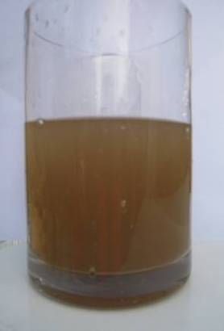
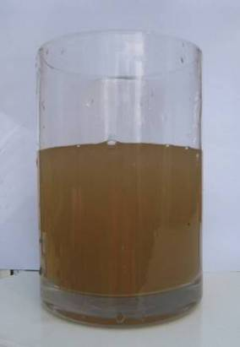
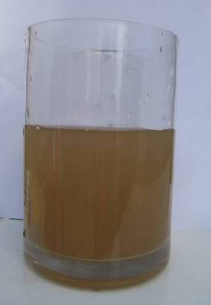
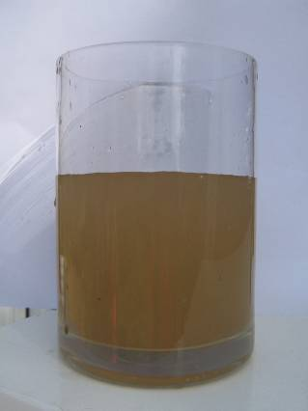
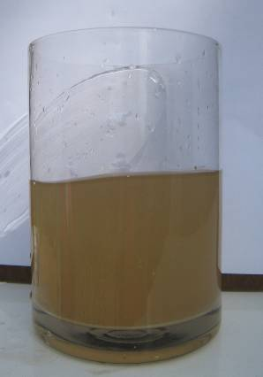
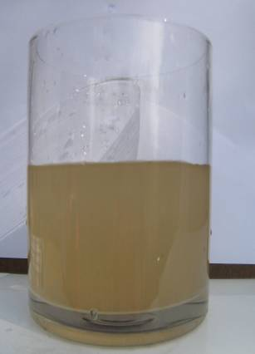
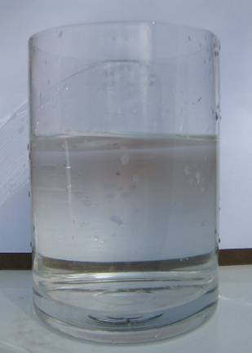
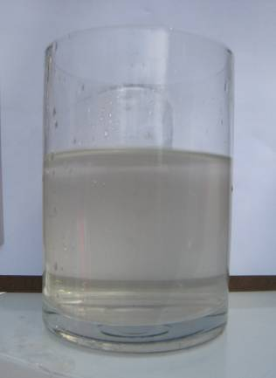
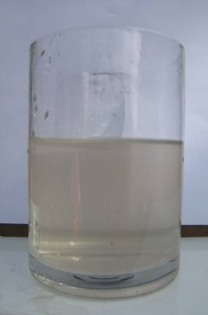
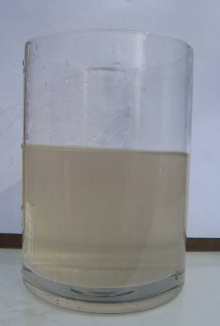
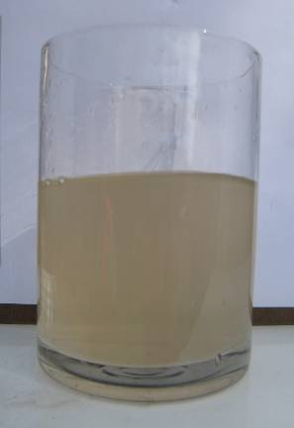
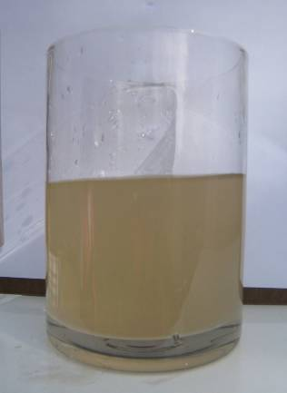
Turbidity Readings - Visual Comparisons
933 NTU
745 NTU
584 NTU
477 NTU
404 NTU
283 NTU
4 NTU
44 NTU
64 NTU
107 NTU
140 NTU
216 NTU
Readings Above Turbidity NEL (violation)
Readings Above Turbidity NAL (call to action)
Readings Below Turbidity NAL

Slide 18
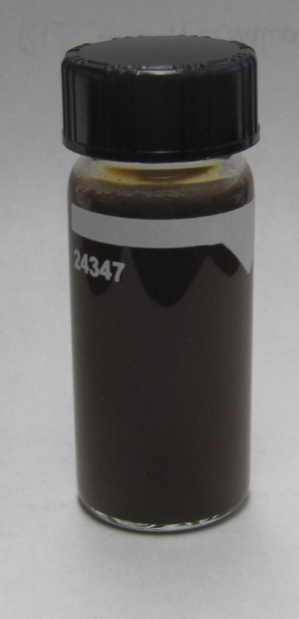
Can You Estimate Turbidity?
Sample #1
Sample #2
Notes:
Sample 1: 37.2 NTU
Sample 2: >1000 NTU
Sample 2: after 10:1 dilution, measured 372 NTU
Goes to show that you can’t judge turbidity without a turbidity meter.

Slide 19
Certification and Training
Qualified SWPPP Developer (QSD)
Writes and prepares SWPPP
Must obtain registrations/certifications by 7/1/2010
Must attend three-day training by 9/2/2011
Must pass QSD exam by 9/2/2011
Qualified SWPPP Practitioner (QSP)
Responsible for the implementation of the SWPPP and REAP
Must obtain registrations/certifications by 9/2/2011
Must attend two-day training by 9/2/2011
Must pass QSP exam by 9/2/2011

Slide 20
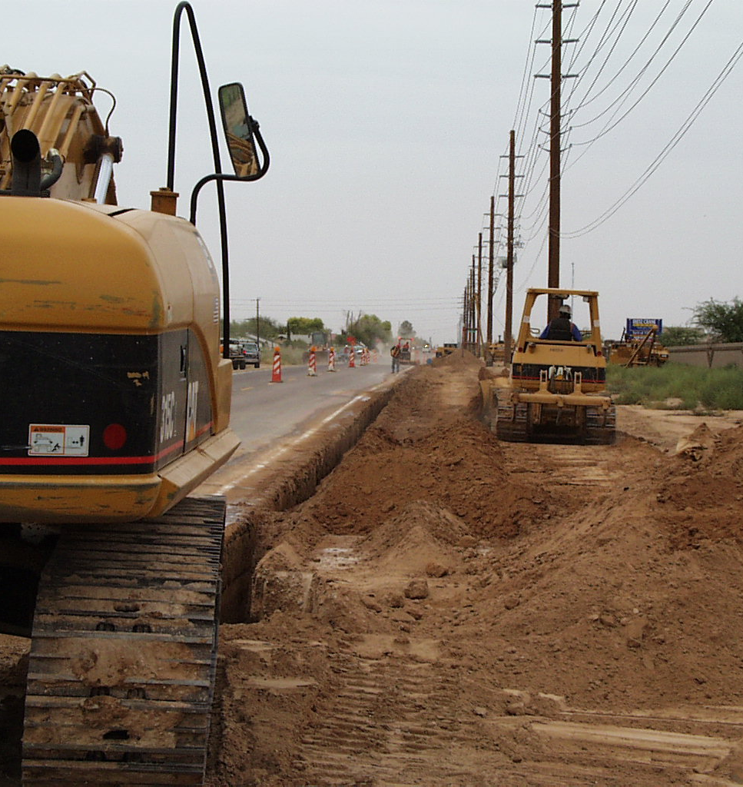
Example Project – Start to Finish
New shopping center
Risk Level 2 project
Risk Level 2 field requirements:
SWPPP implementation
Weekly BMP inspection (documented)
Daily visual inspection
Storm event inspections (pre/during/post storm)
Quarterly non-stormwater inspection
Rain Event Action Plan (REAP)
Storm event monitoring for pH and turbidity
BMP installation and maintenance
20

Slide 21
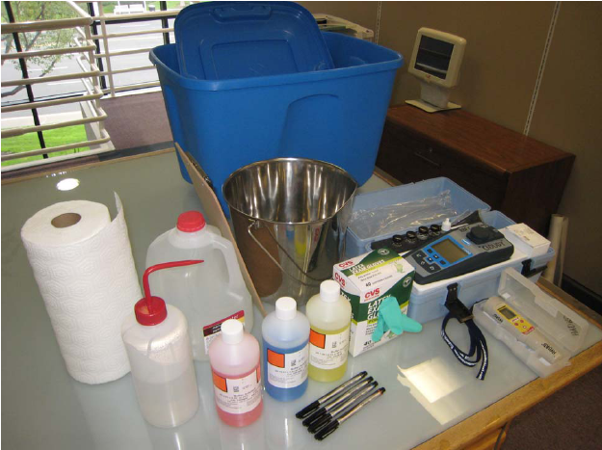
2 Weeks Prior to Construction
Permit coverage acquired
SWPPP developed
Field inspector/QSP receives the SWPPP
Prepare for stormwater monitoring
Train the contractor

Slide 22
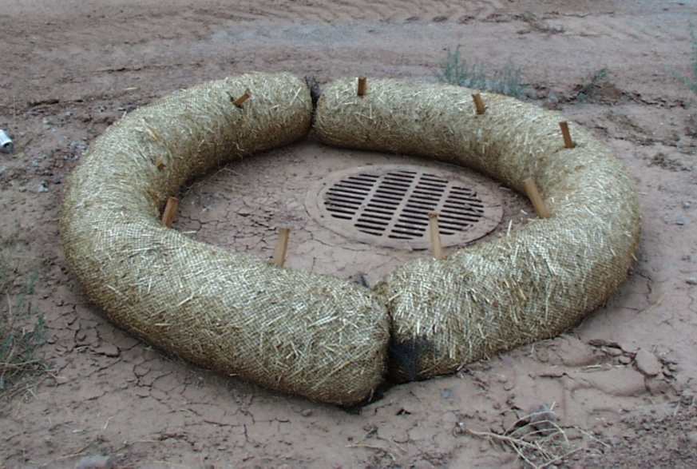
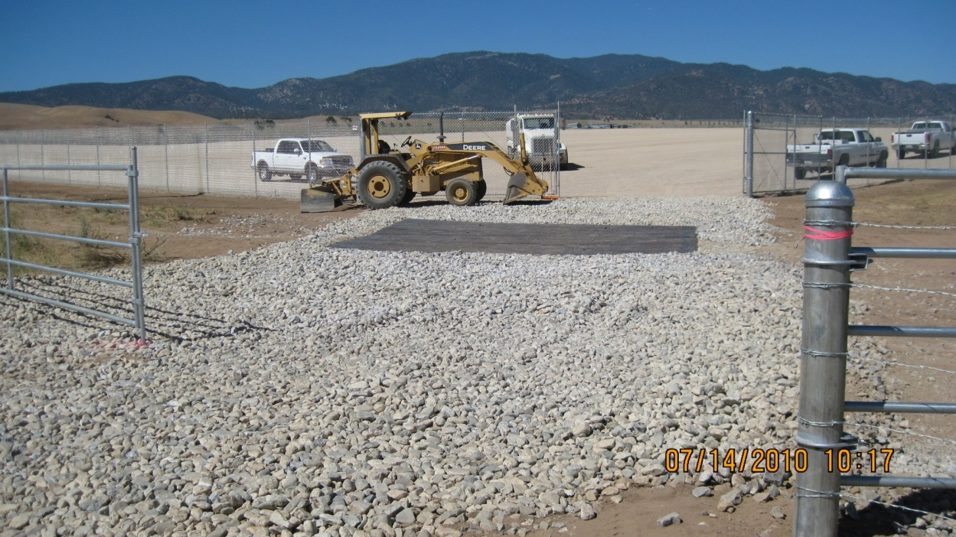
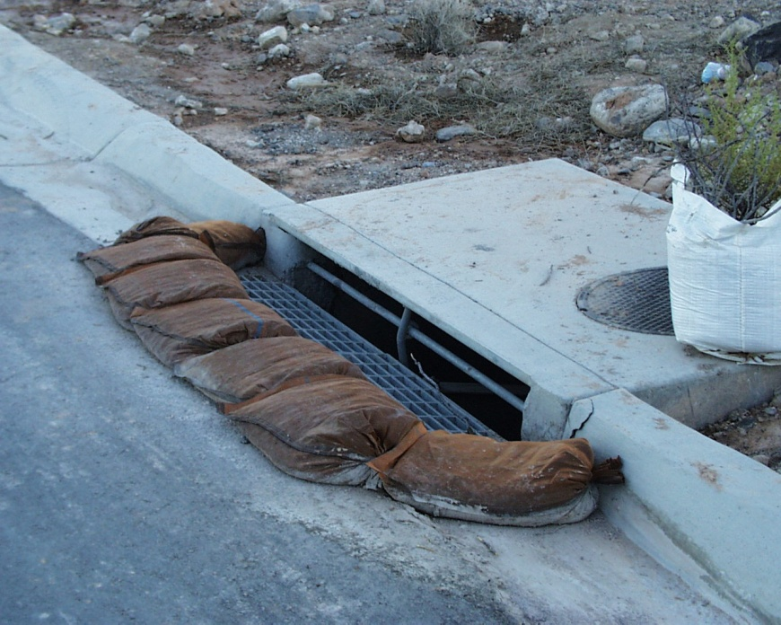
Start of Construction
Prior to grading or trenching:
Install tracking control BMPs
Install laydown area BMPs
Install inlet protection BMPs
Note: The SWPPP map must always reflect the BMPs on the site!
22

Slide 23
Start of Construction
Begin weekly and quarterly inspections
Begin daily visual track-out inspections
Maintain log sheet of visual inspections in SWPPP
Check NOAA website (weather.gov) daily for rain forecasts
Perform pre, during, and post storm inspections as needed
Develop Rain Event Action Plan as needed
Begin monitoring
Non-visible pollutants (upon spill)
pH and turbidity (during rain events)
23

Slide 24
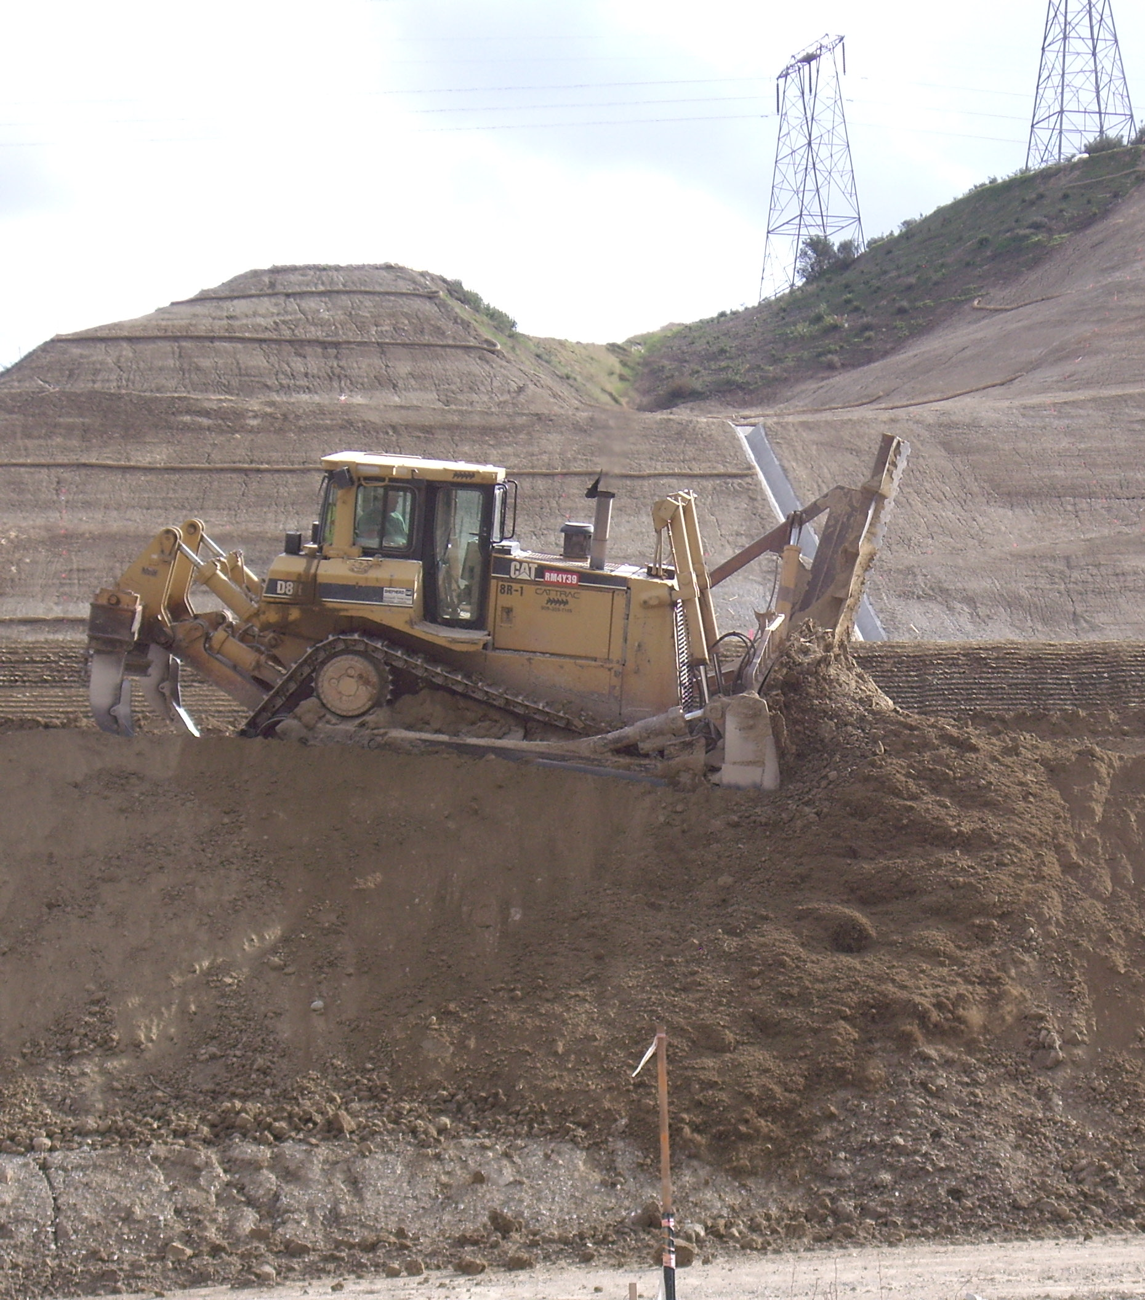
55% Chance of Rain Forecasted
50% is the trigger for a storm event
Develop a REAP
Conduct pre-storm site inspection
Fill out inspection checklist
Take photos of the site
Install BMPs to protect active areas from rain event
Prepare to sample runoff from all ACTIVE construction areas for pH and turbidity
QSP or person trained by the QSP must perform inspections
24

Slide 25
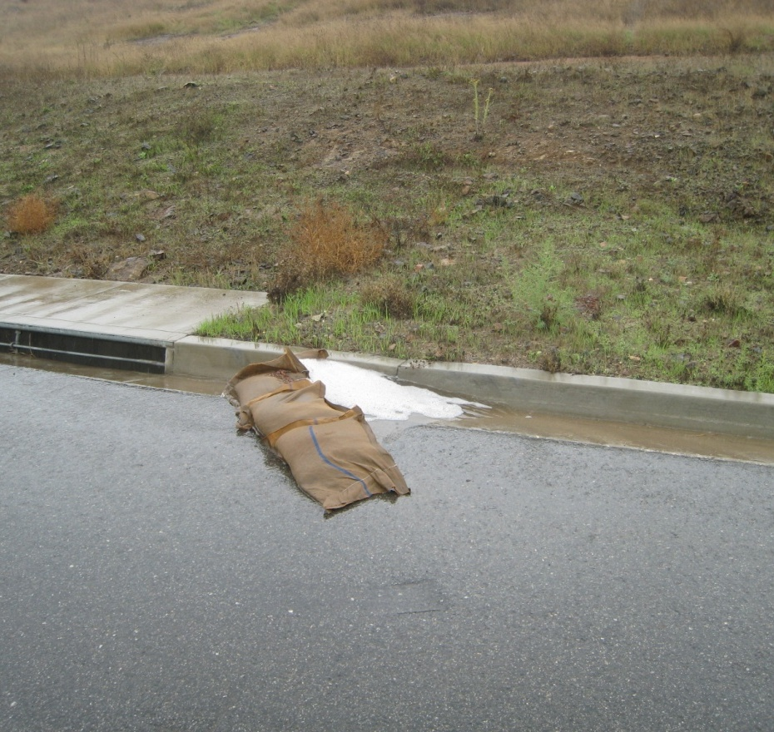
Rain Event Occurs
Conduct storm-event inspection
Fill out site inspection checklist
Take photos of site
Use SWPPP map to identify BMPs that should be on site
Sample runoff for pH and turbidity minimum of 3 times per day
Sample where discharge leaves the project site
Sampled runoff must be representative of all site runoff
All pH and turbidity measurements must be made in the field (use portable instruments)
25

Slide 26
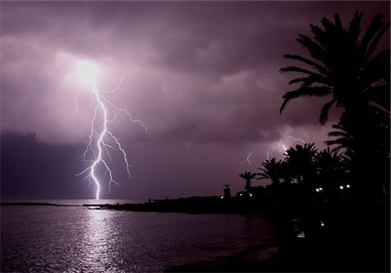
Rain Event Occurs
Follow Monitoring & Reporting Plan in SWPPP
If site is deemed “unsafe”, sampling is not required
26

Slide 27
Post-Storm
Conduct post-storm inspection within 48 hours
Fill out inspection checklist
Take photos of site
Repair BMPs as needed
Coordinate with QSP to deliver monitoring results
pH and turbidity data must be uploaded to SMARTS if there are exceedances of the Numeric Action Levels
Store all completed inspection records in the SWPPP
Records must be maintained for 3 years
27

Slide 28
During Construction
Stop inspecting and monitoring at completed/stabilized areas of the project (with proper documentation)
Continue BMP maintenance
Continue to check NOAA website (noaa.gov) for rain event forecasts
If a Regional Board inspector visits your project, you MUST allow them access, and show them your SWPPP
If you have questions on the SWPPP or the permit, call your City stormwater coordinator
28

Slide 29
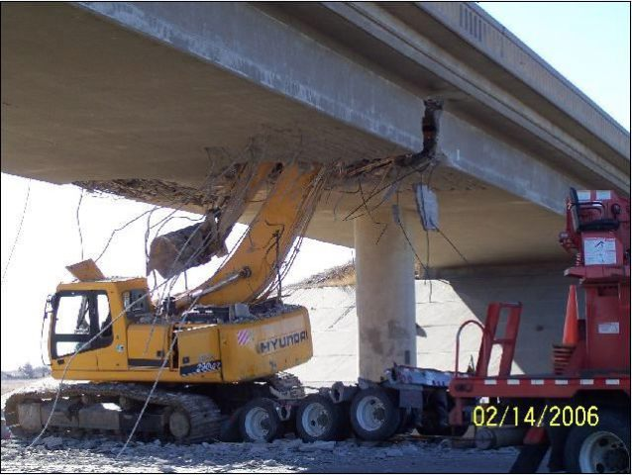
If NAL Exceedance Occurs
Contact QSP to initiate reporting
Determine where BMPs failed
Repair BMPs or install additional BMPs
29

Slide 30
Tips for Achieving Compliance
Ensure that the QSP completes all administrative requirements
Inspections, SWPPP maintenance
The SWPPP map should always show exactly which BMPs are installed. It’s the first thing an inspector will ask to see during an inspection!
Never allow trackout
Prevent trash from blowing off the site
Concrete washouts must be water tight
Always be forthright with Regional Board inspectors.
If a BMP breaks, somebody has to fix it!

Slide 31
Construction BMP Review
Erosion controls
Sediment controls
Tracking controls
Material and waste storage
31

Slide 32
When Should BMPs be Implemented?
Perimeter controls should be installed before breaking ground
In preparation for a rain event
In all areas that have been inactive for >14 days
At all times – ‘appropriate’. This means if there is a discharge, there is no excuse
Permit does not have a ‘rainy season’
32

Slide 33
Erosion Controls
Erosion controls provide 80% of sediment management
Sediment controls provide 20% of sediment management
Protect surface from rain drop impact
Help retain moisture in the soil
Minimize the down-slope transport of soil particles
They will degrade over time
33

Slide 34
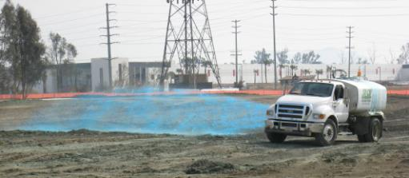
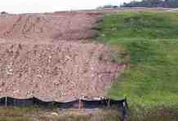
Erosion Controls: Soil Binder
Generally temporary and may require reapplication
Soil type dictates kind of soil binder to use
Must be environmentally benign
Typically last 3 -12 months
Polyacrylamide (PAM) is an effective, low cost option
34

Slide 35
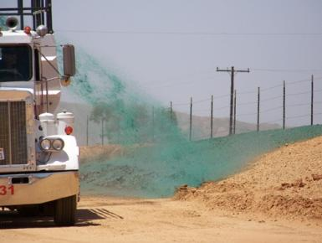
Erosion Controls: Mulches Hydraulic Mulch/Bonded Fiber Matrix
Most types need 24 hours to dry before rainfall occurs
Hydraulic mulch generally good for 3 – 6 months
Bonded Fiber Matrix may last several wet seasons
Mixture of mulch and binder
Maximum slope about 4:1
Place over previously seeded
area, or add seeds to the mixture
35
V

Slide 36
Erosion Controls: Rolled Erosion Control Products
Used when disturbed soil may be difficult to stabilize or drying time an issue
Blankets and mats may need to be removed and disposed of prior to application of permanent soil stabilization
Install perpendicular to contours
36

Slide 37
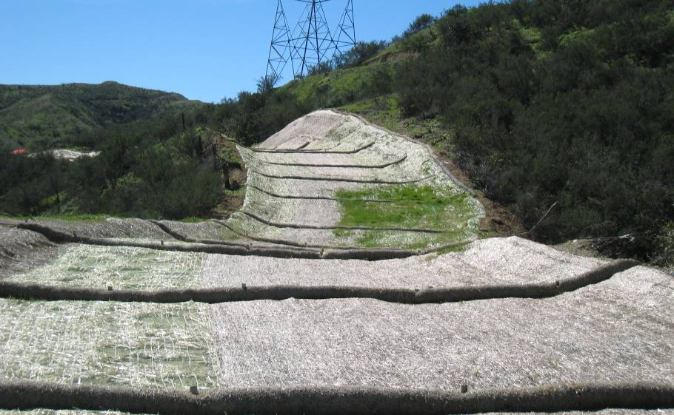
37
V

Slide 38
Erosion Control Cost/Performance
Category | Material | Cost/acre | Sediment Reduction (%) | Longevity
Binders | Guar | $410 | 80 | Short
 | Starch | $410 | 60 | Short
 | Acrylic polymers | $1,232 | 40 | Short
 | Polyacrylamide | $410 | 55 | Short
Mulches | Straw | $2,100 | 90 | Medium
 | Cellulose Fiber | $900 | 55 | Short
 | Recycled Paper | $900 | 50 | Short
 | Bonded Fiber Matrix | $5,400 | 90 | Medium
Rolled Erosion Control Products | Woven Jute Mesh | $6,500 | 70 | Medium
 | Excelsior | $10,600 | 85 | Long
 | Straw Blanket | $9,000 | 87 | Long
 | Coir (coconut shells) | $13,000 | 80 | Long
 | Plastic Mesh Woven | $2,000 | 80 | Long
38

Slide 39
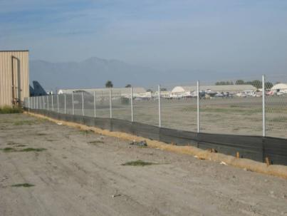
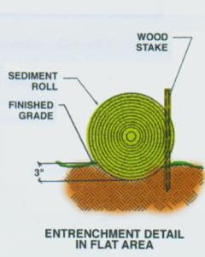
Sediment Controls: Fiber Rolls
Locate on level contours
Use at top and on face of slopes
Good for perimeter control
Use recommended spacing in 2009 CGP
Must be installed correctly: trenched and staked
39

Slide 40
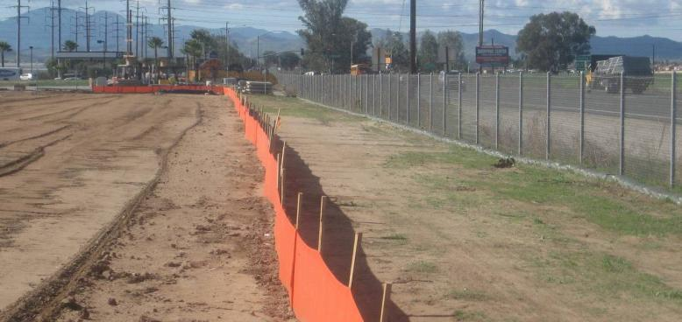
Sediment Controls: Silt Fence
Located level on contours, not perpendicular
Not for concentrated flow areas
Must be keyed in (bottom six inches must be buried)
40

Slide 41
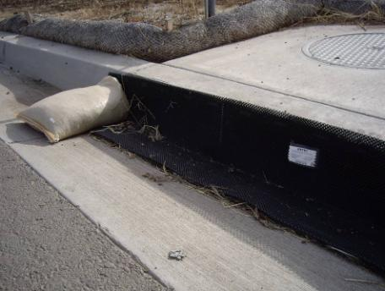
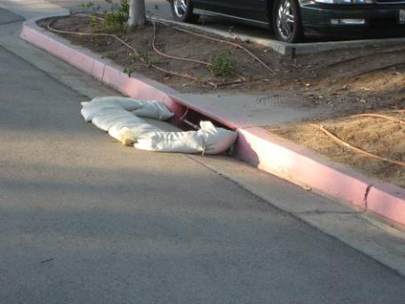
Sediment Control: Inlet Protection
Protect active inlets year-round
Use where ponding won’t encroach into traffic
Maintain/clean out after every storm
41

Slide 42
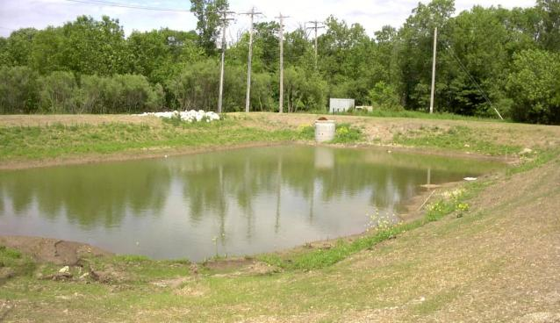
Sediment Control: Sediment Ponds
Capture and de-silt sediment laden runoff
Use for large drainages and steep slopes where erosion control is not feasible
Maintain/clean out on an as needed basis
42

Slide 43
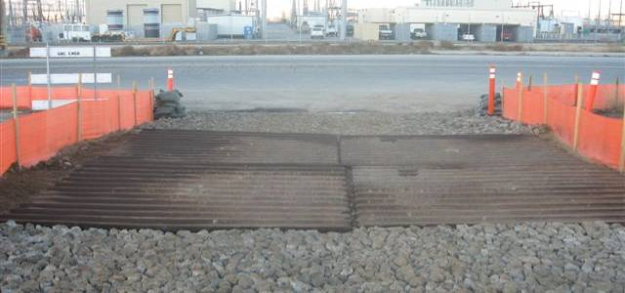
Tracking Controls
A VERY visible indicator of compliance effort (or lack of)
Minimize number of access points
Use coarse aggregate over filter fabric
Year-round requirement
In high traffic areas, street sweepers may be needed
43

Slide 44
Sediment Control Summary
BMP | Application | Flow Type | Cost | Longevity
Silt Fence | Perimeter Protection | Sheet flow | $3.50 - $9/foot | 12-36 mo
Reinforced S.F. | Sediment Trap | Shallow conc. | high end of SF | 12-36 mo
Fiber Roll | Perimeter, inlet | Sheet flow | $1/foot (plus installation) | 12-36 mo
Sed. Basin | Online/offline | Concentrated | $2000/drainage acre | Indefinite
Inlet Filter | Inlet Protection | Concentrated | $200/inlet | 12-24 mo
Rock Entrance | Tracking Controls | N/a | $1200-$4800 | 1-2 rain events
Rumble Plate | Tracking Controls | N/a | $1200-$4800 | Indefinite
44

Slide 45
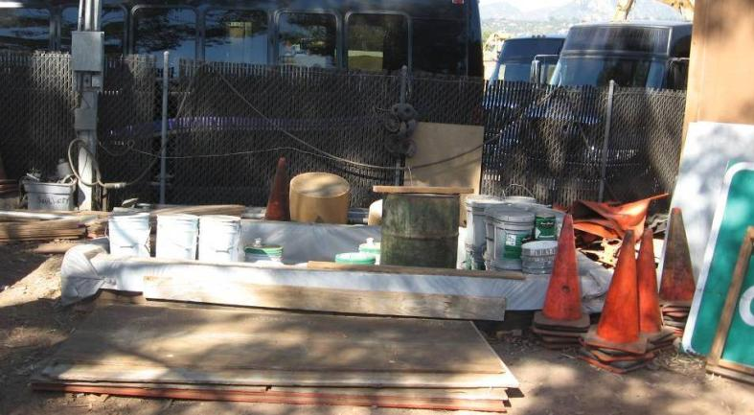
Material Storage
Cover and contain
Keeps site clean / good housekeeping
Avoids potential sampling for non-visible pollutants
45

Slide 46
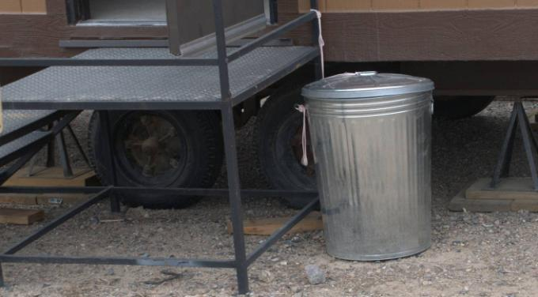
Waste Management
Debris discharge from site is a permit violation!
Cover trash containers
Provide water-tight concrete washouts
46

Slide 47
Example Photos

Slide 48
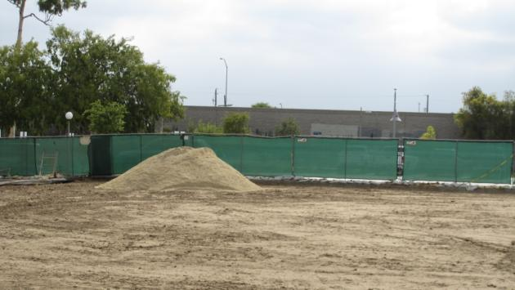
Soil Stabilization
Potential Violation:
Inactive area with no erosion control

Slide 49
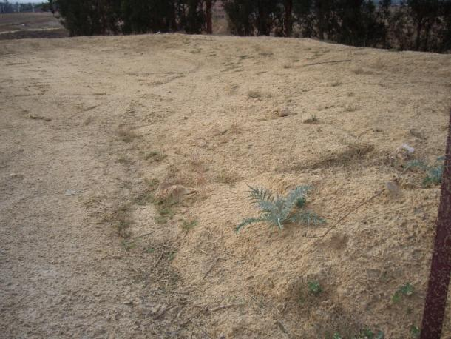
Soil Stabilization
Better Practice:
Inactive area with erosion control BMPs

Slide 50
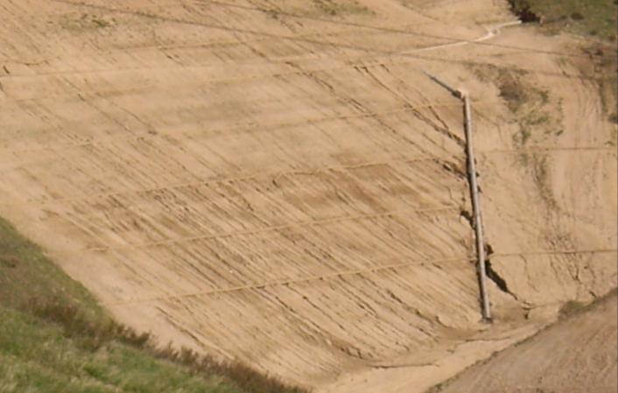
Slope Stabilization
Potential Violation:
Inactive slope with poor stabilization

Slide 51
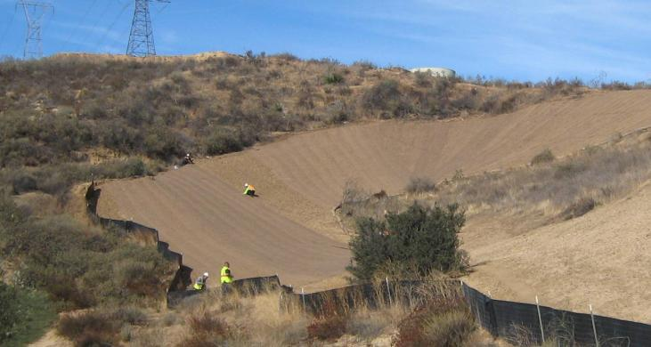
Slope Stabilization
Better Practice
Application of soil stabilization BMPs

Slide 52
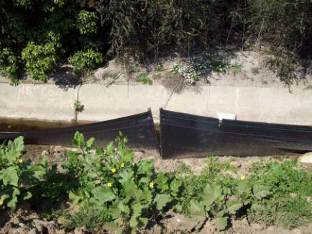
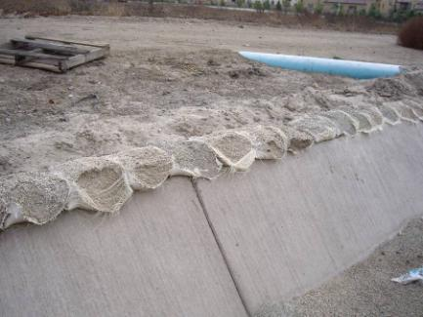
Site Perimeter
Potential Violations
Damaged / ineffective protection

Slide 53
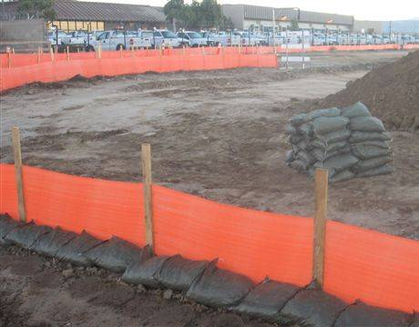
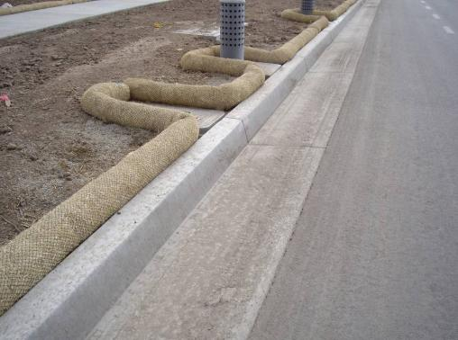
Site Perimeter
Better Practice
Proper controls & placement, well-maintained

Slide 54
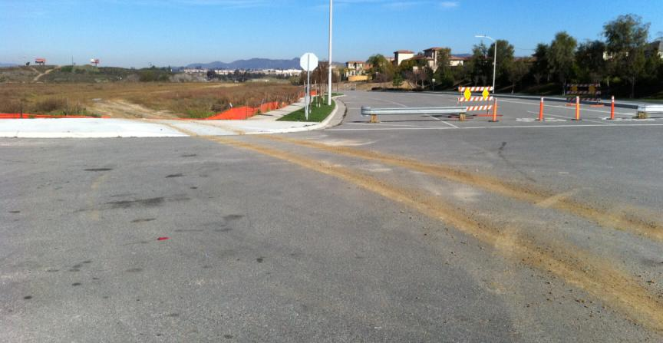
Dirt Tracking
Potential Violations
Dirt tracked onto streets,
lack of training

Slide 55
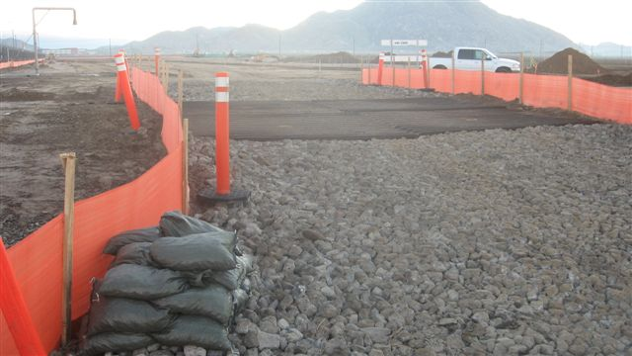
Dirt Tracking
Better Practice
Stabilized lot & site entrances
Gravel & plates free of excessive dirt
Do not avoid stabilization measures – use them!

Slide 56
Dust Control
Potential Violations
No dust control

Slide 57
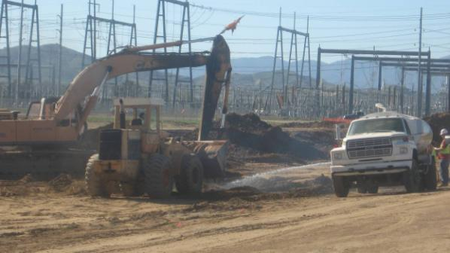
Dust Control
Better Practice
Use water trucks for dust control

Slide 58
Stockpile Management
Potential Violations
Improper placement
No measures to prevent material discharges

Slide 59
Stockpile Management
Better Practice
Provide perimeter protection
Cover for long periods or before rain events
Notes:
Possibly mention that straw matting may be preferred with the new permit. Plastic degrades and falls apart in the sun.

Slide 60
Inlet Protection
Potential Violations
Improper installation
Lack of maintenance

Slide 61
Inlet Protection
Better Practice
Use products properly
Actively maintain BMPs
Prevent damage to devices
Prevent pollutants from entering inlets

Slide 62
Poor Silt Fence Application

Slide 63
Silt Fence
Potential Violations
Poor installation
Lack of maintenance

Slide 64
Silt Fence
Better Practice
Proper installation
Maintained

Slide 65
Streets and Sidewalks
Potential Violation
Clean regularly – dry sweep or vacuum
No water unless runoff directed away from drain inlets to pervious areas

Slide 66
Streets and Sidewalks
Better Practice
Well maintained

Slide 67
Construction Material Storage
Potential Violations
No protection of soil

Slide 68
Construction Material Storage
Better Practice
Cover, berm, and contain

Slide 69
Washout Pits
Potential Violation
Not using washout at all
Leaking / ineffective washout

Slide 70
Washout Pits
Better Practice
Contractors must use a designated concrete washout
Do not overfill
Washout must be water tight

Slide 71
Leaking Equipment
Potential Violations
Leaks onto ground & no clean up
Damaged drip pans
Flat oil trays
Plastic does not prevent runoff

Slide 72
Leaking Equipment
Better Practice

Slide 73
Construction Waste
Potential Violations
Good housekeeping is critical

Slide 74
Construction Waste
Better Practice
Cover trash cans/bins when storm is predicted
Empty at least every week

Slide 75
Sawcutting
Potential Violation
Better Practice
Discharge to gutter/storm drain
Vacuum saw cut slurry
Away from concentrated flow paths

Slide 76
Secondary Containment
Potential Violations
Storage of fuel/oils
Improper storage
No containment

Slide 77
Secondary Containment
Better Practice
Do not store fuel on site
Use proper secondary containment

Slide 78
Portable Toilets
Potential Violation
Avoid placement in street gutter / flow areas

Slide 79
Portable Toilets
Better Practice
Placed out of gutters and flow paths

Slide 80
Good or Bad?

Slide 81
Good or Bad?

Slide 82
Good or Bad?

Slide 83
Good or Bad?
Notes:
Entrances/ inlet protection, fill at end of street.

Slide 84
Good or Bad?

Slide 85
Good or Bad?
Notes:
No controls. Will go onto street.

Slide 86
Good or Bad?

Slide 87
Good or Bad?
Notes:
No final stabilization.
Dirt in street.

Slide 88
Good or Bad?

Slide 89
Good or Bad?

Slide 90
Good or Bad?

